Slide 1

Github Tutorial
Team 6328
Software Engineering

Slide 2
What is version control?
A system that keeps records of your changes
Allows for collaborative development
Separate “streams” of work that can be brought back together
Allows you to know who made what changes and when
Allows you to revert any changes and go back to a previous state

Slide 3

What is GitHub?
www.github.com
Largest web-based git repository hosting service
Aka, hosts ‘remote repositories’
Allows for code collaboration with anyone online
Adds extra functionality on top of git
UI, documentation, bug tracking, feature requests, pull requests, and more!
Octocat!

Slide 4
Install git
Linux (Debian)
Command: sudo apt-get install git
Linux (Fedora)
Command: sudo yum install git
Mac
http://git-scm.com/download/mac
Windows
http://git-scm.com/download/win

Slide 5
Create your Github account
Navigate to www.github.com
Click on “Sign Up”
Walk through the signup
You should have an account created and no repositories under your name

Slide 6
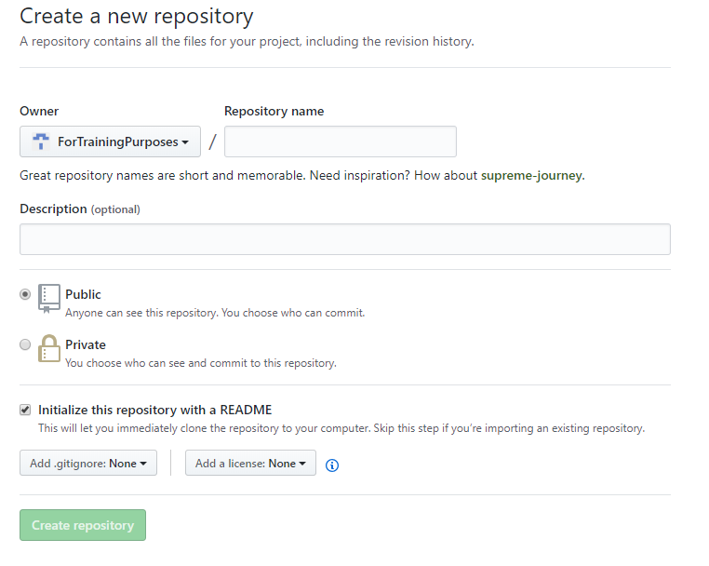
Create your first repository

Slide 7
Key Concepts: Repositories
Often shortened to ‘repo’
A collection of all the files and the history of those files
Consists of all your commits
Place where all your hard work is stored

Slide 8
GIT: a Distributed system
Some version control systems (like Subversion) are based around a central server
Only the working copy is local
GIT is Distributed version control
Your computer clones the entire repo
But knows where it came from (upstream)
Local repo is fully functional without network
Changes can be pushed to and pulled from upstream

Slide 9
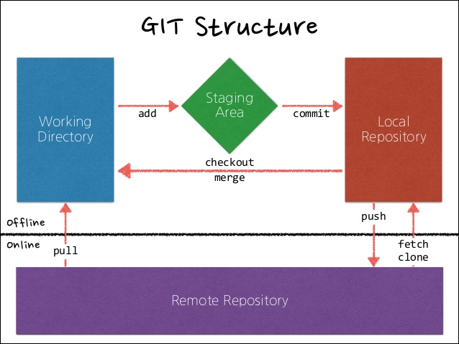
System view of GIT
Source: fabacademy.org

Slide 10
Key Concepts
snapshot
commit
A “picture” of your files at a point in time
Your code history looks like a series of snapshots
You control when they are taken
Can go “back in time” to any snapshot, later on
The act of creating a snapshot
Can be a noun or verb
“I committed code”
“I just made a new commit”
Essentially, a project is made up of a bunch of commits

Slide 11
Key Concepts: CommitS
Commits contain three pieces of information:
Information about how the files changed from previously
A reference to the commit that came before it
Called the “parent commit”
A hash code name
Will look something like:
fb2d2ec5069fc6776c80b3ad6b7cbde3cade4e

Slide 12
Key Concepts: Repository operations
Git fetch: updates the local repo from the upstream, but doesn’t merge changes into the working copy
Git pull: fetches changes and merges them to the working copy
Git push: transfers changes from your repo back to the upstream one

Slide 13

Key Concepts: Branches
The main branch in a project is called the master branch
Each branch is a variant of the master
All commits in git live on some branch
But there can be many, many branches

Slide 14
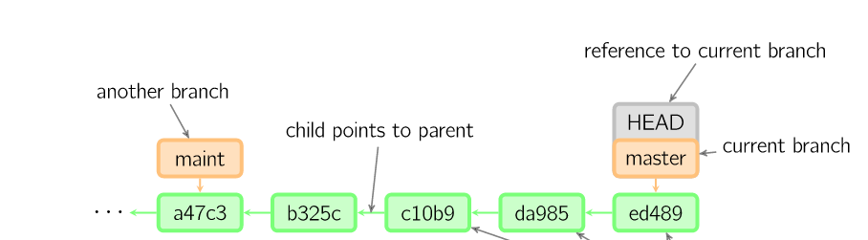
a Simple project
Time going forward

Slide 15
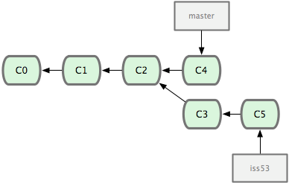
Branching
The start of a branch points to a specific commit
When you want to make a set of related changes to your project (like a new feature) you make a new branch based on a commit
Time going forward

Slide 16
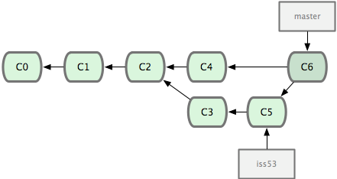
Key Concepts: Merging
Once you’re done with your feature, you merge it back into master
Time going forward

Slide 17
Commit Process
Make some changes to a file (or several)
Use the ‘git add’ command to put the file onto the staging environment
Use the ‘git commit’ command to create a new commit
Or can autostage on commit

Slide 18
Additional Resources
Oﬃcial git site and tutorial:
https://git-scm.com/
GitHub guides:
https://guides.github.com/
Command cheatsheet:
https://training.github.com/kit/ downloads/github-git-cheat-sheet.pdf
Interactive git tutorial:
https://try.github.io/levels/1/challenges/1
Visual/interactive cheatsheet:
http://ndpsoftware.com/git-cheatsheet.html

